Slide 1
Object Oriented Programming in C#
by Microsoft
at www.edx.org
Mitja Kocjančič

Slide 2


Notes:
edX is a MOOC platform that offers variety of subject including Computer Science that we are interested in

Slide 3
COURSE

Slide 4


Instructors
Gerry O'Brien
Senior Content Development Manager Microsoft
Libby Knell
HIGH SCHOOL INTERN, L&R Microsoft

Slide 5
What you will learn
Core object-oriented programming concepts
How to create and use classes and objects in a C# application
Applying the three core OOP concepts using C#
A grasp of memory and resource management in C# and the .NET Framework

Slide 6
Structure of the course
Class
Reading lectures
Video lectures (optional)
Self-Checks
Assigments
Help
Discussion
Wiki
Microsoft Docs (Additional resources)

Slide 7
OOP in C#
Length: 3 Weeks
Effort: 3 to 5 hours per week
Self-paced
Every week 1 LAB Assessment
Every sub-module has a 2 small Tests

Slide 8
Week 1
Introduction to OOP
Classes
Encapsulation
Static methods and Static Classes
Additional resources
Lab Assignment

Slide 9
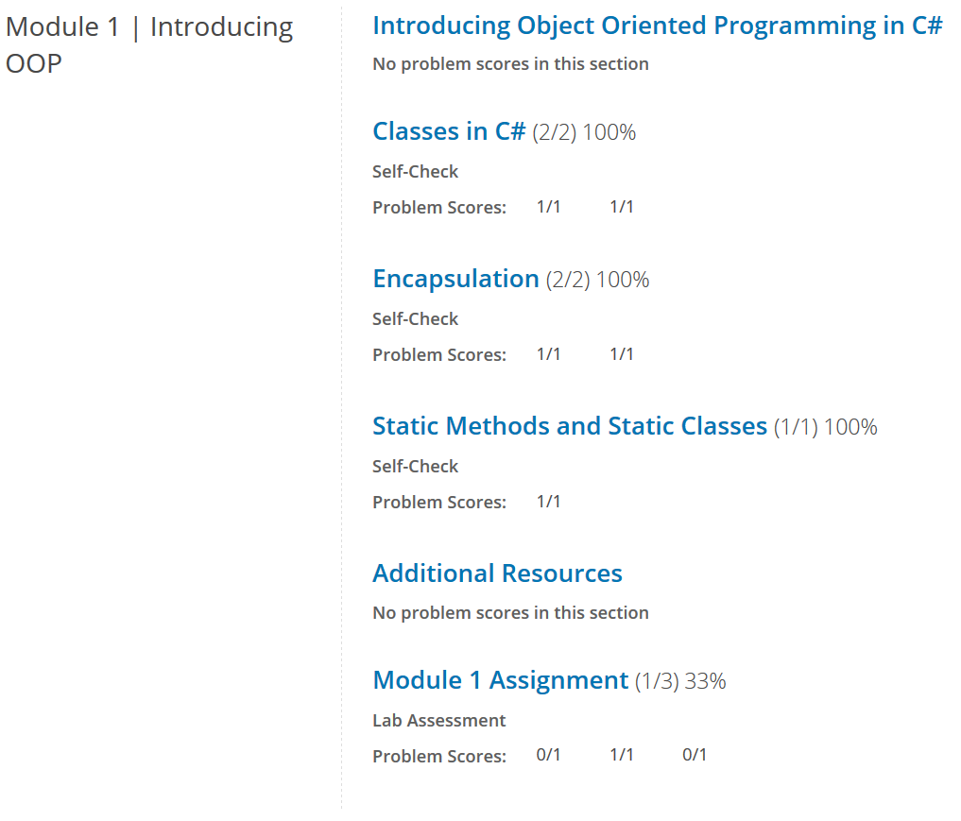

Slide 10
Week 2
Anonymous Classes
Inheritance
Abstract Classes and Sealed Classes
Interfaces and Polymorphism
Additional resources
Self-check

Slide 11
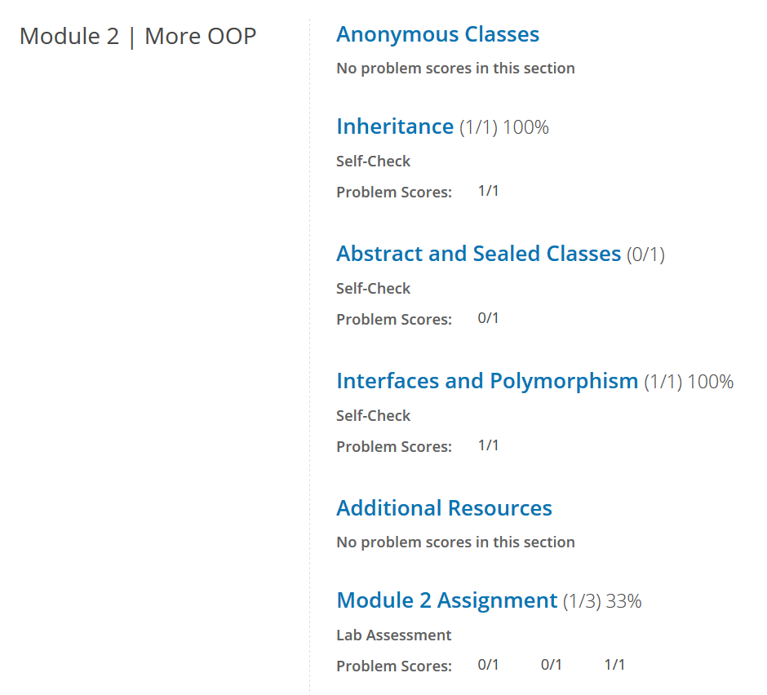

Slide 12
Week 3
Introduction Memory Managment
Additional resources
Lab Assignment

Slide 13
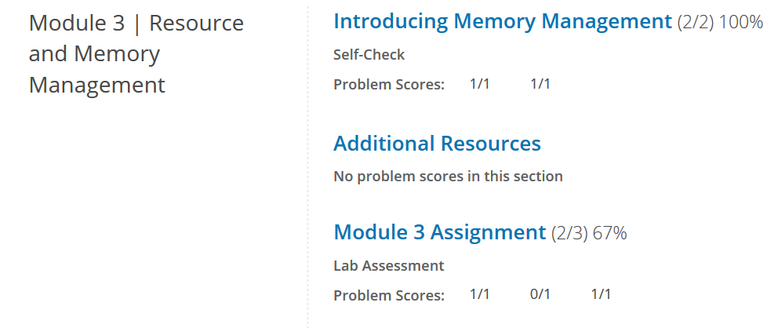

Slide 14

https://www.youtube.com/watch?v=5cDpy047iQY

Slide 15
Post Course Survey
What did you learn type

Slide 16
NO CERTIFICATE
edX doesn‘t give certificates without paying them
Nice way to learn if you like learning that way

Slide 17
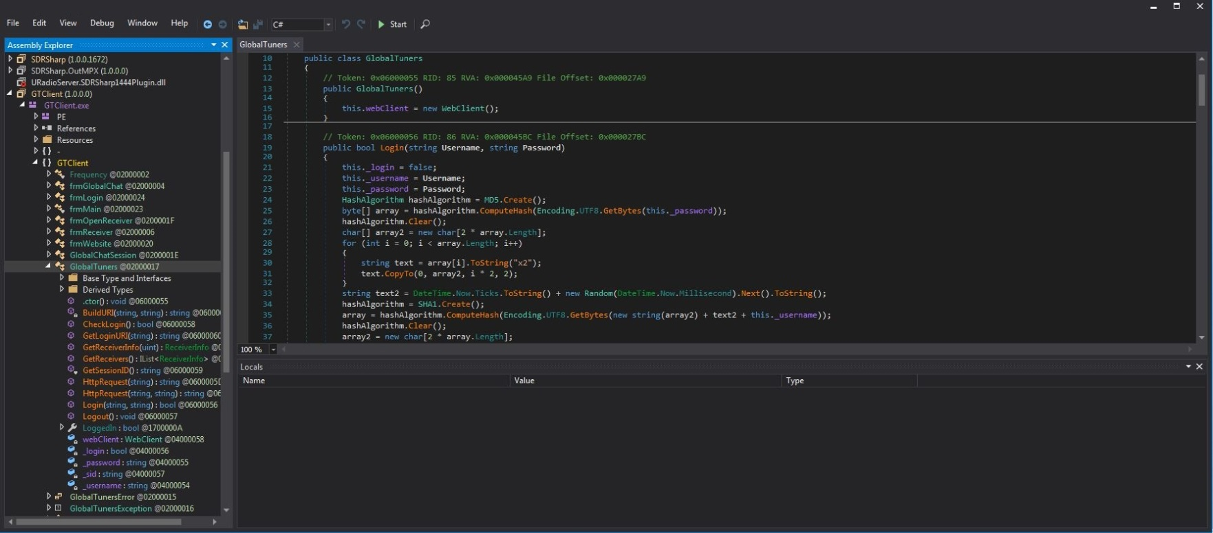
NOT MY WAY
What does it do?

Slide 18
THE END
OOP in C#: https://bit.ly/2OW6eyi

